Slide 1
Briefly Full stack web development

Slide 2
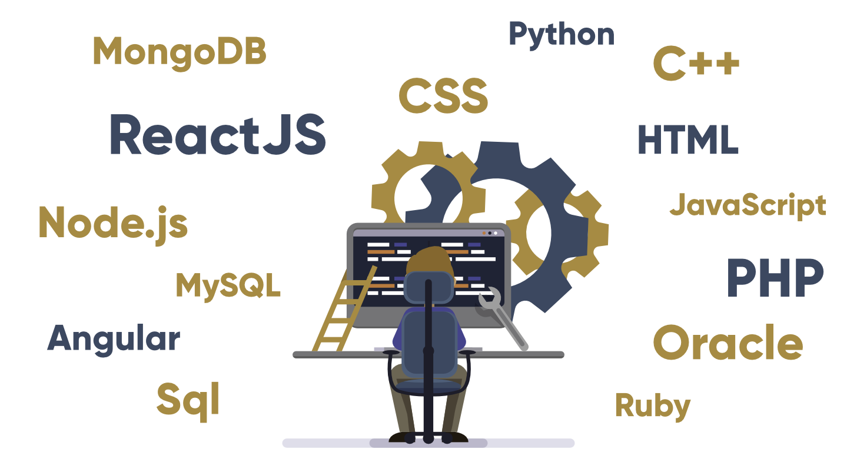
Full stack Development: The development of both front end(client side) and back end (Server side) portion of Web application.
Full Stack Web Developer: A full stack web developer is a person who can develop both client and server software. Full stack web developers have the ability to design complete web application and web sites. They work on the front end, back end, database and debugging of web application or websites.
Full stack developer is “jack of all trade, master on none”.

Slide 3
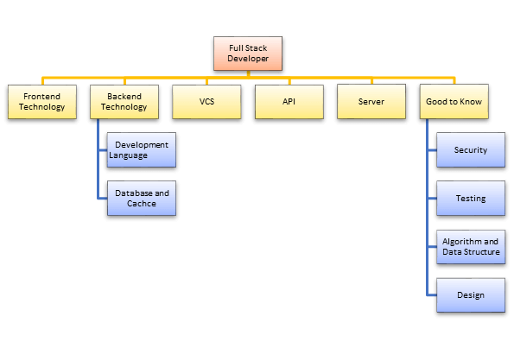
Why Do You Need a Full-Stack Developer?
Full stack developer helps you to keep every part of the system running smoothly
Full stack developer can provide help to everyone in the team and greatly reduce the time and technical costs of team communication
If one person plays different roles, it saves your company's personnel, infrastructure and operational cost.
Full Stack Developer Skills You Need to Know:

Slide 4
1) Front-end technology
Full stack developer should be master of essential front-end technologies like HTML5, CSS3, JavaScript. Knowledge of third-party libraries like jQuery, Bootstrap, LESS, AngularJSand ReactJS,SASS is desirable
2) Development Languages
Full stack engineer should know at least one server-side programming languages like Java, Python, Ruby, .Net,PHP,C++,Node.js.
3) Database and cache
Knowledge of various DBMS technology is another important need of full stack developer. MySQL, MongoDB, Oracle, SQLServer are widely used for this purpose. Knowledge of caching mechanisms like varnish, Memcached, Redis is a plus.
4) Basic design ability
In order to become a successful Full Stack web developer, the knowledge of designing is also recommended. Moreover, the person should know the principle of basic prototype design and UI /UX design.

Slide 5
5) Server
Exposure to handling Apache or nginx servers is desirable. A good background in Linux helps tremendously in administering servers.
6) Version control system (VCS)
A version control system allows full stack developers to keep track of all the changes made in the codebase. The knowledge of Git helps full stack developers to understand how to get the latest code, update parts of the code, make changes in other developer's code without breaking things.
7) Working with API (REST & SOAP):
Knowledge of web services or API is also important for full stack developers. Knowledge of creations and consumption of REST and SOAP services is desirable.
SOAP (Simple Object Access Protocol) is a standards-based web services access protocol that has been around for a long time. ... REST (Representational State Transfer) is another standard, made in response to SOAP's shortcomings. It seeks to fix the problems with SOAP and provide a simpler method of accessing web services.

Slide 6
Advantages
You can master all the techniques involved in a development project
You can make a prototype very rapidly
You can provide help to all the team members
You can reduce the cost of the project
You can reduce the time used for team communication
You can switch between front and back end development based on requirements
You can better understand all aspects of new and upcoming technologies

Slide 7
Disadvantages
The solution chosen can be wrong for the project
The solution chosen can be dependent on developer skills
The solution can generate a key person risk
Being a full stack developer is increasingly complex

Slide 8
What is a Software Stack?
Software stack is a collection of the programs which are used together to produce a specific result. It includes an operating system and its application. For example, a smartphone software stack includes OS along with the phone app, web browsers, and default applications.
Popular Stacks:
LAMP stack: Linux - Apache - MySQL - PHP
MERN: MongoDB - Express - React Js - Node.js
MEAN stack: MongoDB - Express - AngularJS - Node.js
Django stack: Python - Django - MySQL
Ruby on Rails: Ruby - SQLite - Rails

